Slide 1
TOY JOY INVENTORY OPTIMIZATION ANALYSIS
Analyzing Sales and Inventory Trends for Better Decision Making

Slide 2
BUSINESS PROBLEM
Excess inventory observed after holiday season
Some products overstocked → increased holding cost
Some products out of stock → lost sales
Need better inventory planning

Slide 3
OBJECTIVES
Identify overstock products
Identify high-demand products
Analyze seasonal sales trends
Optimize inventory management

Slide 4
DATASET OVERVIEW
Data from 2023 to 2025
Includes:
Sales data
Inventory levels
Stockout information
Data cleaning done:
Fixed category names
Handled missing values

Slide 5
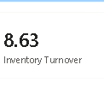
KEY KPI’S
Revenue shows total sales performance
Units Sold indicates product demand
Inventory Turnover measures stock efficiency
Stockout Rate shows lost sales due to no stock
Excess Inventory indicates unsold stock value

Slide 6
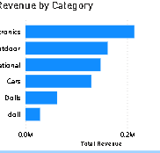
Sales by Category
Shows revenue distribution across categories
Identifies top-performing categories
Highlights low-performing segments

Slide 7
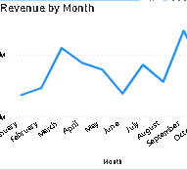
Monthly Sales Trend
Shows sales trend over time
Identifies seasonal demand patterns
Highlights peak sales periods

Slide 8
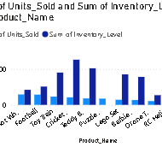
Inventory vs Sales
Compares inventory levels with sales
Identifies overstock and understock products
Helps understand stock imbalance

Slide 9
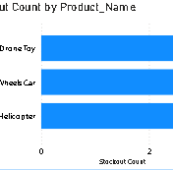
Stock out Analysis
Shows products frequently out of stock
Indicates high-demand items
Helps identify lost sales opportunities

Slide 10
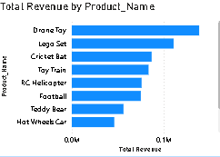
Top Products by Revenue
Displays best-performing products
Highlights major revenue contributors
Helps focus on high-value items

Slide 11
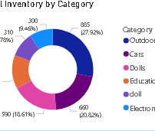
Category-Wise Inventory
Shows inventory distribution across categories
Identifies where stock is concentrated
Helps in inventory planning

Slide 12
Recommendations
Reduce stock for slow-moving products
Increase stock for high-demand items
Use seasonal forecasting
Set proper reorder levels
Optimize inventory planning

Slide 13
Conclusion
Inventory optimization improves profitability
Reduces stockouts and excess stock
Data-driven decisions improve efficiency

